Slide 1
Descriptive Analysis for Heart Disease Prediction Data Note: Associated data: https://d.docs.live.net/66e5ecfe158147c5/Public/Capstone%20Project/Heart_Disease_Prediction_Descriptive_Analysis.xlsx

Slide 2
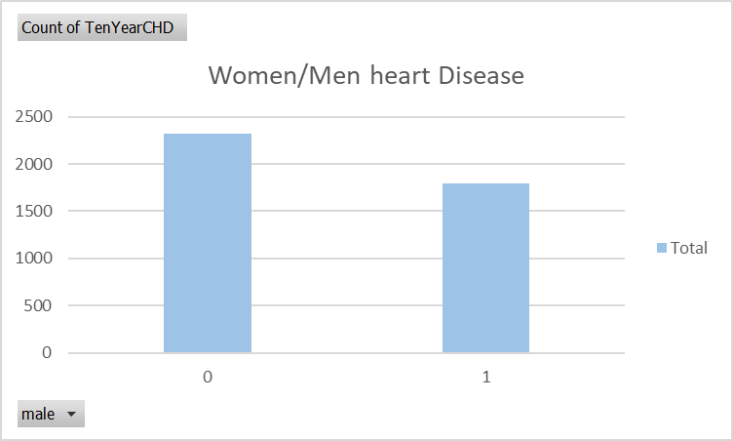
85.1% never had a heart disease. 14.89% of participants had chronic heart disease in last 10 years .
0= without heart disease.1 = with heart disease
More number of women have had a heart disease compared to men
0= Women
1= Men

Slide 3
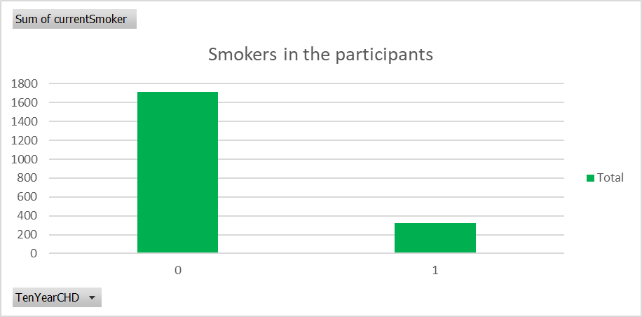
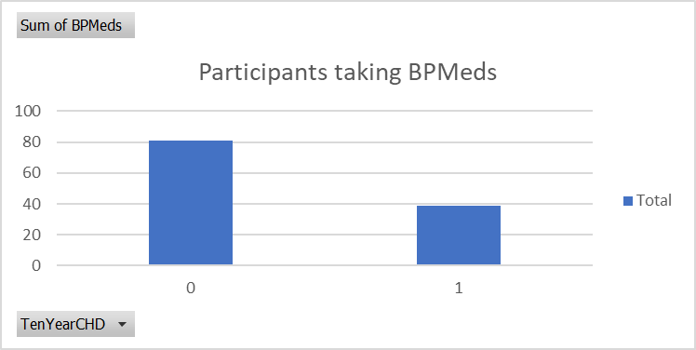
There are more non-smokers than smokers amongst the participants.
0= Non-Smokers.
1 = Smokers
More participants not taking BP meds compared to those taking medicines
0 = No BP Meds
1 = Yes BP Meds

Slide 4
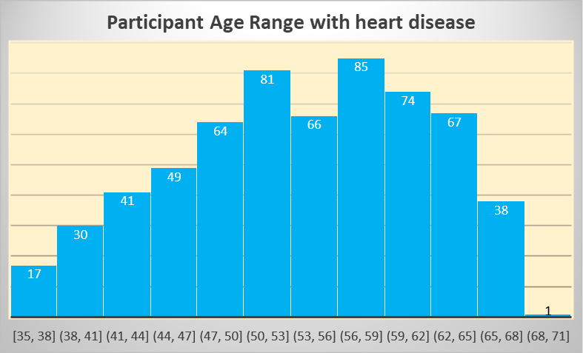
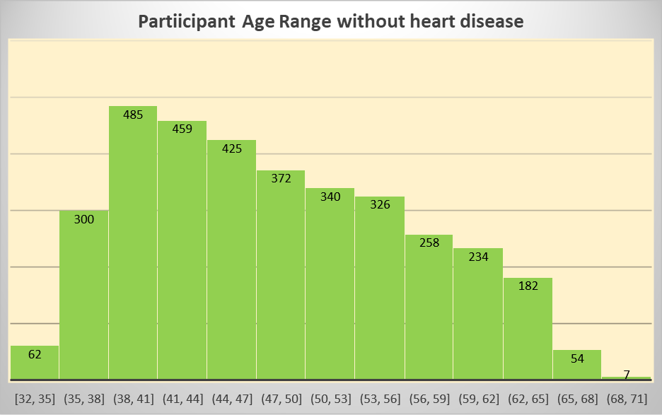
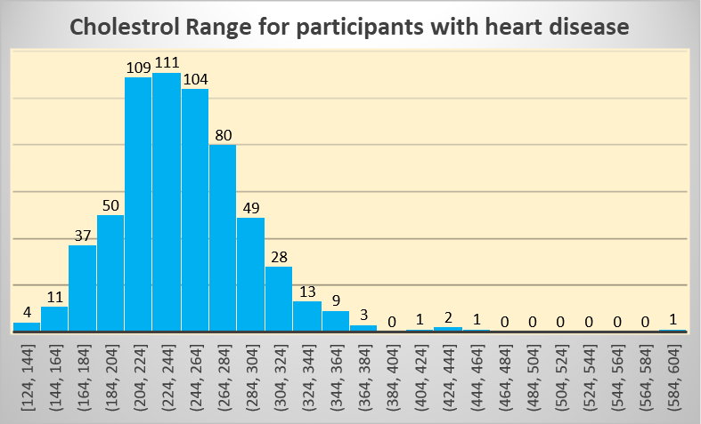
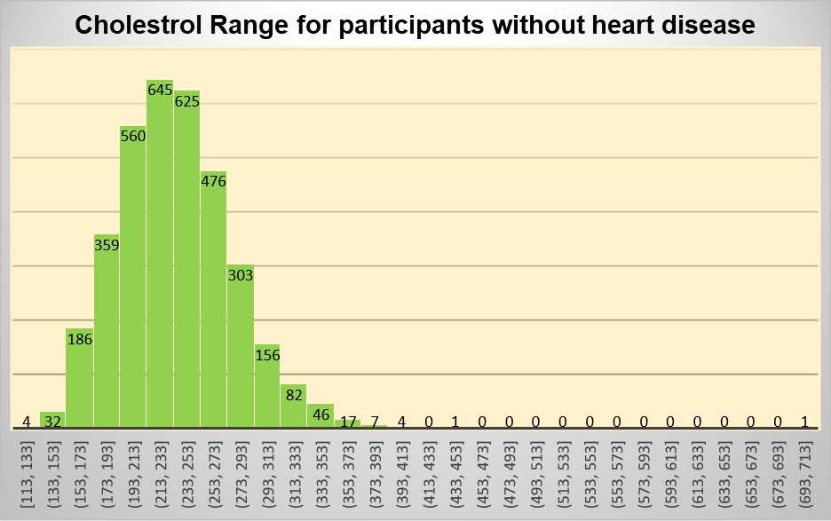
Comparison of Participants with and with out history of heart disease
Observation: Participants who have had heart disease detected are mostly middle aged ranging between 45-65 yrs of age,compared to participants without heart disease who are fairly younger.
Observation: There is not much difference in cholestrol ranges between participants with or without heart disease

Slide 5
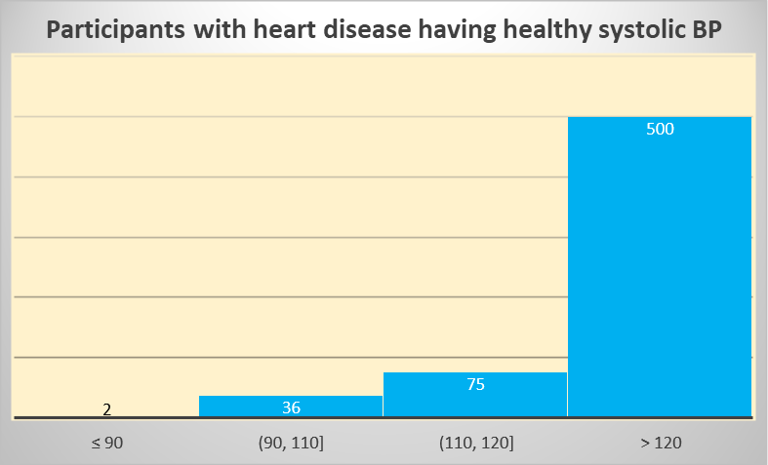
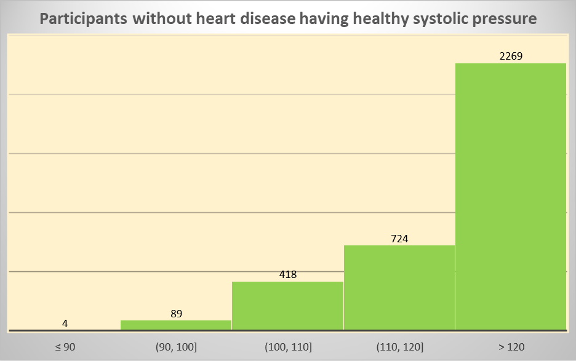
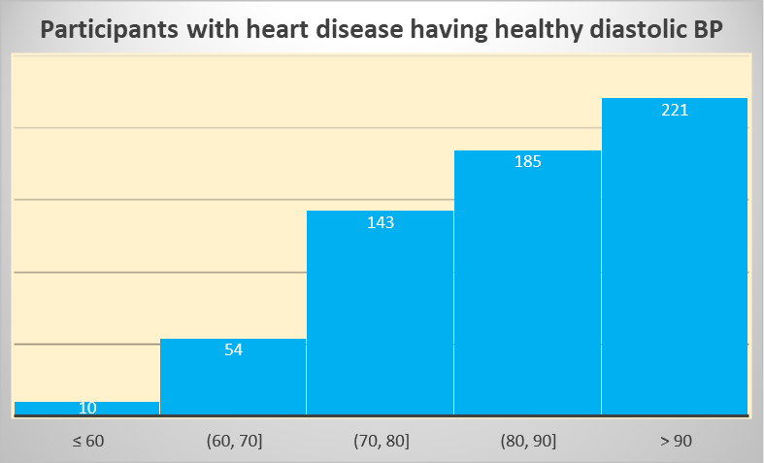
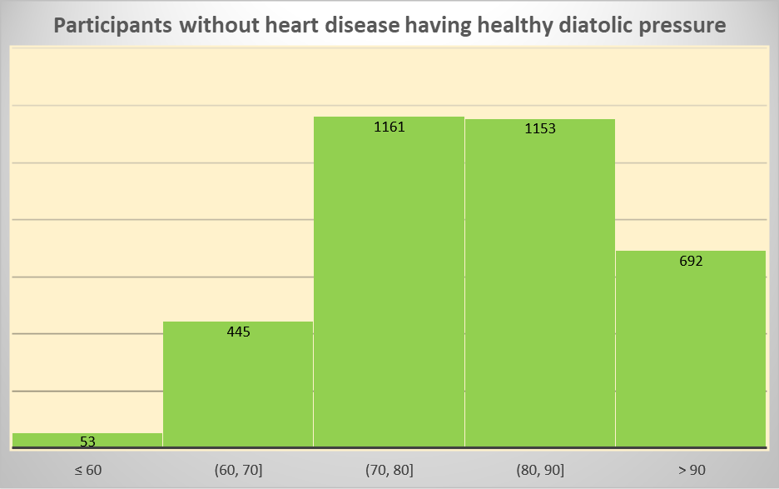
Comparison of Participants with and with out history of heart disease
Observation: Most participants have high systolic pressure, beyond normal range irrespective of having heart disease
Observation: W.R.T diastolic pressure, participants with history of heart disease tend to have higher BP which is above the normal range, when compared to participants without heart disease.

Slide 6
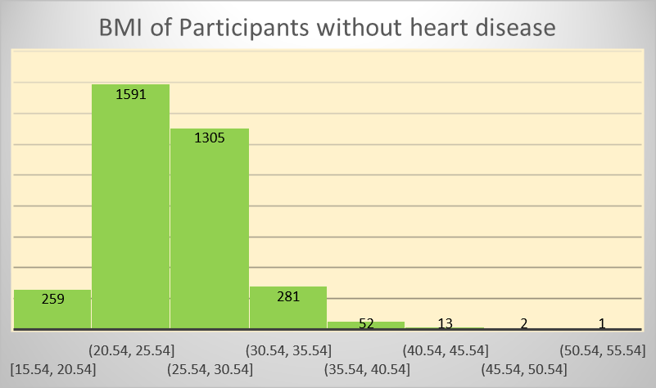
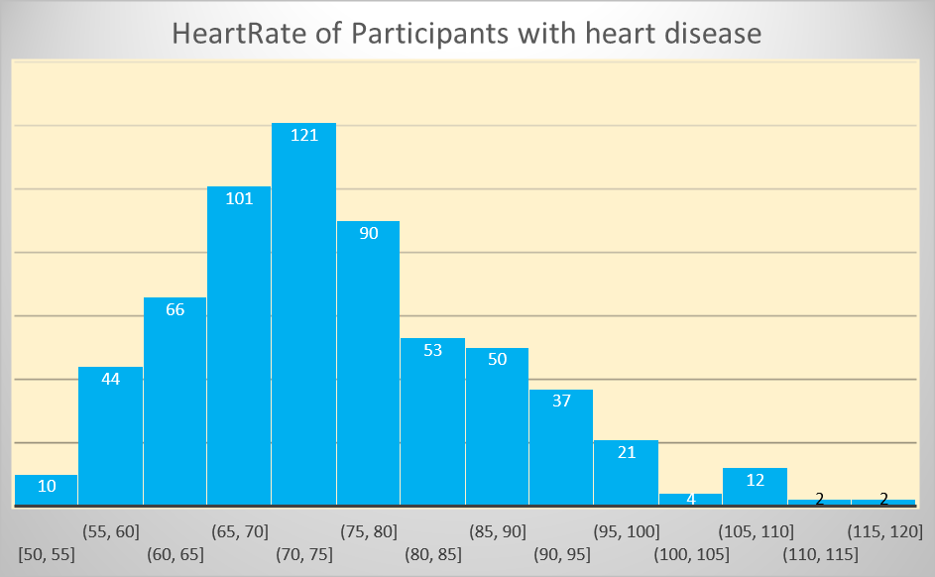
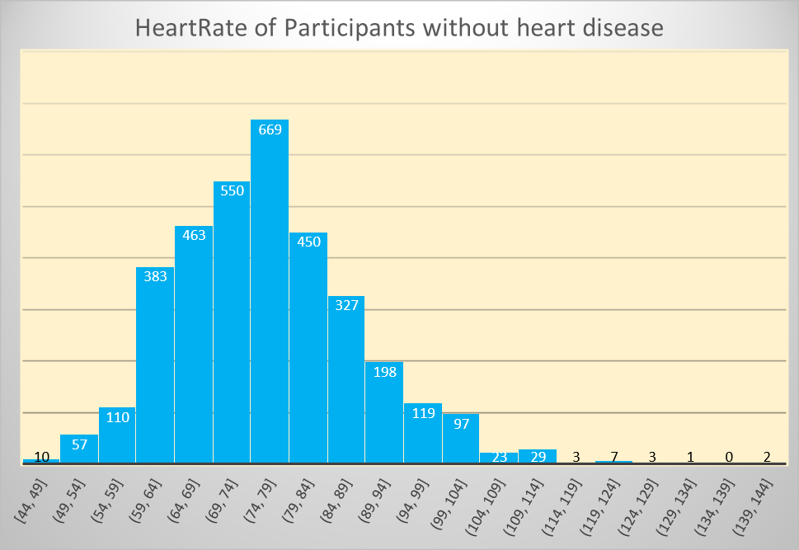
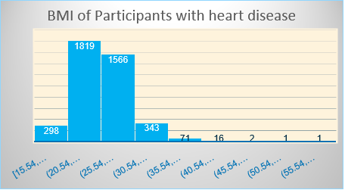
Comparison of Participants with and with out history of heart disease
Observation: BMI for all participants ranges almost same irrespective of having history of heart disease
Observation: Most of participants with heart disease have heart rate ranging between 60 and 80 which also holds true for participants without heart diseases

Slide 7
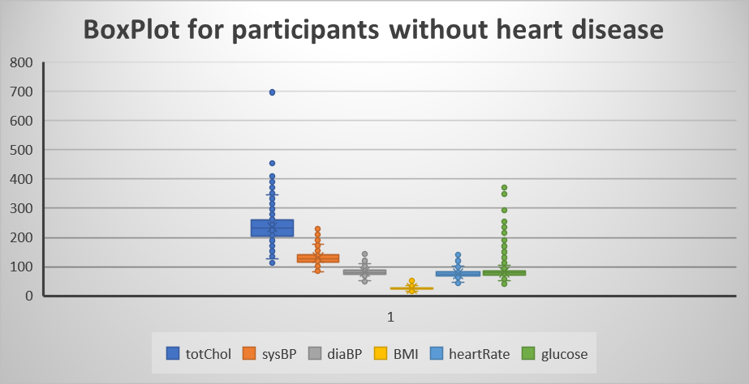
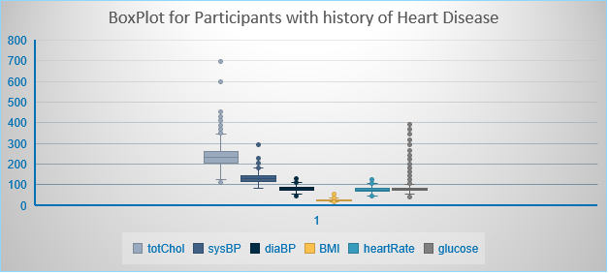

Slide 8
Summary: With around 4000 participants , descriptive analysis of the given dataset have found that there are certain attributes such as, age, diastolic pressure that seem to have a direct effect on heart diseases as compared to the rest. We need to further do an inferential analysis to find the extent to which there are dependencies .

